Slide 2

Problem statement
• Farmers in India struggle to identify cattle & buffalo breeds.
• Breed identification affects milk yield, disease resistance & income.
• Lack of tools leads to poor breeding & financial losses.

Slide 3
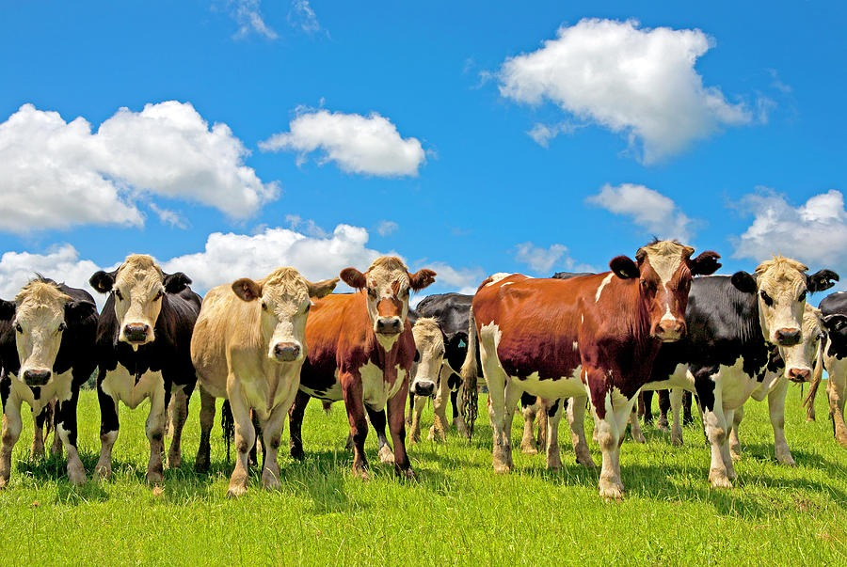



BUILD AN AI- POWERED SYSTEM TO IDENTIFY INDIAN CATTLE & BUFFALOES BREEDS
BUILD AI
DEVELOP AN
ANDROID APP
IMPROVE PRODUCTIVITY

Slide 4


BUILD AI
DEVELOP AN
ANDROID APP
IMPROVE PRODUCTIVITY
CREATE A MOBILE APP TO USE EASILY FOR THE FARMERS TO IDENTIFY THE BREEDS

Slide 5

IMPROVING PRODUCTIVITY,DECISION MAKING AND FARMER INCOME
BUILD AI
DEVELOP AN
ANDROID APP
IMPROVE PRODUCTIVITY

Slide 6
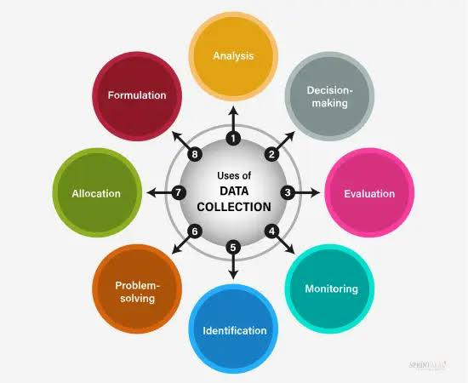

DATA SET& DATA COLLECTION
Collected 5,000+ images of major Indian breeds (Gir, Murrah, Sahiwal, etc.).
• Sources: open datasets, government portals, field photography.
• Images labeled with breed name for training.

Slide 7

AI MODEL TRAINING
• Used Convolutional Neural Networks (CNNs).
• Model trained to detect horn shape, coat color, body size.
• Accuracy achieved: 87% on validation dataset.

Slide 8
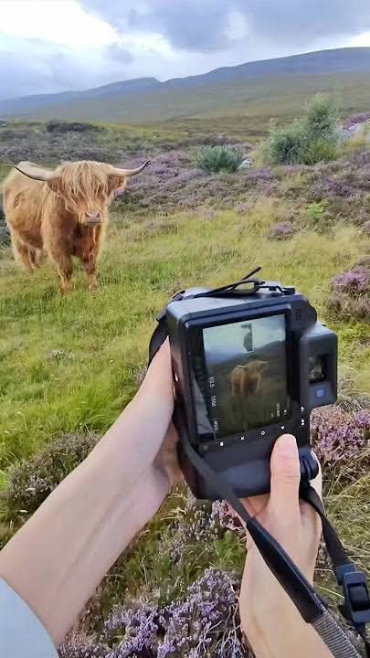

MOBILE APPLICATION DEVELOPMENT
• Built a lightweight Android app.
• Farmer clicks photo ? App identifies breed.
• Provides breed info: milk yield, traits,
disease resistance.
• Supports multiple languages.

Slide 9
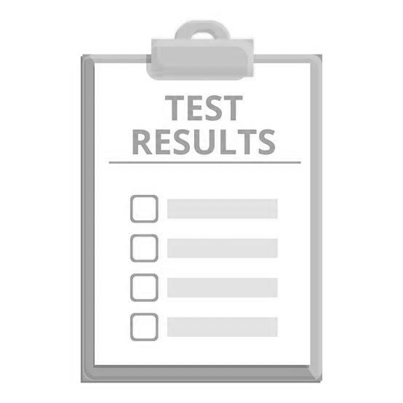
TESTING & RESULTS
• Pilot tested with 50 farmers in Gujarat & Haryana.
• Farmers could identify breeds with 85–90% success.
• Feedback: app easy to use and time-saving.

Slide 10
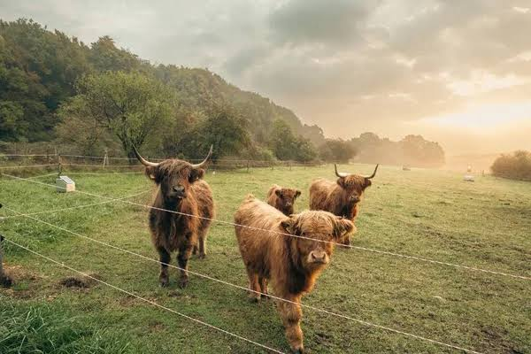
CHALLENGES FACED
• Collecting large, high-quality datasets.
• Variation in lighting & angles during photography.
• Need for offline support in rural areas.

Slide 11

FUTURE SCOPE
• Expand database to 20,000+ images.
• Add recognition of cross-breeds & rare breeds.
• Integrate veterinary advice & milk yield prediction.
• Partner with government for large-scale adoption.

Slide 12

CONCLUSION
1.Developed an AI-powered mobile app that identifies Indian cattle & buffalo breeds with 87% accuracy.
2.Farmers can easily capture photos to get breed details, boosting productivity and income.
3.Scalable solution with potential for nationwide adoption through expanded datasets and features.

